Slide 1
HTML5

Slide 2
Content
Image
Control Elements

Slide 3
HTML Images
Images can improve the design and the appearance of a web page.
The HTML <img> tag is used to embed an image in a web page.
Images are not technically inserted into a web page; images are linked to web pages.
The <img> tag creates a holding space for the referenced image.
The <img> tag is empty, it contains attributes only, and does not have a closing tag.
The <img> tag has two required attributes:
src - Specifies the path to the image
alt - Specifies an alternate text for the image
The broken link icon and the alt text are shown if the browser cannot find the image.

Slide 4
HTML Images
<!DOCTYPE html> <html lang = "en-US"> <head> <title>Images</title> </head> <body>
<img src=“smiley.jpg" alt=“smiley image" width="500" height="600">
<img src="/images/html5.gif" alt="HTML5 Icon" style="width:128px;height:128px;">
<img src="https://www.w3schools.com/images/w3schools_green.jpg" alt="W3Schools.com">
</body>
</html>
Style attribute can be used to specify width and height of the image
Another alternative: Use width and height attribute.
Values are always mentioned in pixels
If images are in subfolder then include folder name in src attribute
Some web sites point to an image on another server.
To point to an image on another server, specify an absolute (full) URL in the src attribute
Animated images are also supported such as gif

Slide 5
HTML Images
<!DOCTYPE html> <html lang = "en-US"> <head> <title>Images</title> </head> <body>
<img src=“smiley.jpg" alt=“smiley image" width="500" height="600">
<img src="/images/html5.gif" alt="HTML5 Icon" style="width:128px;height:128px;">
<img src="https://www.w3schools.com/images/w3schools_green.jpg" alt="W3Schools.com">
</body>
</html>
Common Image Formats
The most common image file types, which are supported in all browsers:
Abbreviation File Format File Extension
APNG Animated Portable Network Graphics .apng
GIF Graphics Interchange Format .gif
ICO Microsoft Icon .ico, .cur
JPEG Joint Photographic Expert Group image .jpg, .jpeg, .jfif, .pjpeg, .pjp
PNG Portable Network Graphics .png
SVG Scalable Vector Graphics .svg

Slide 6
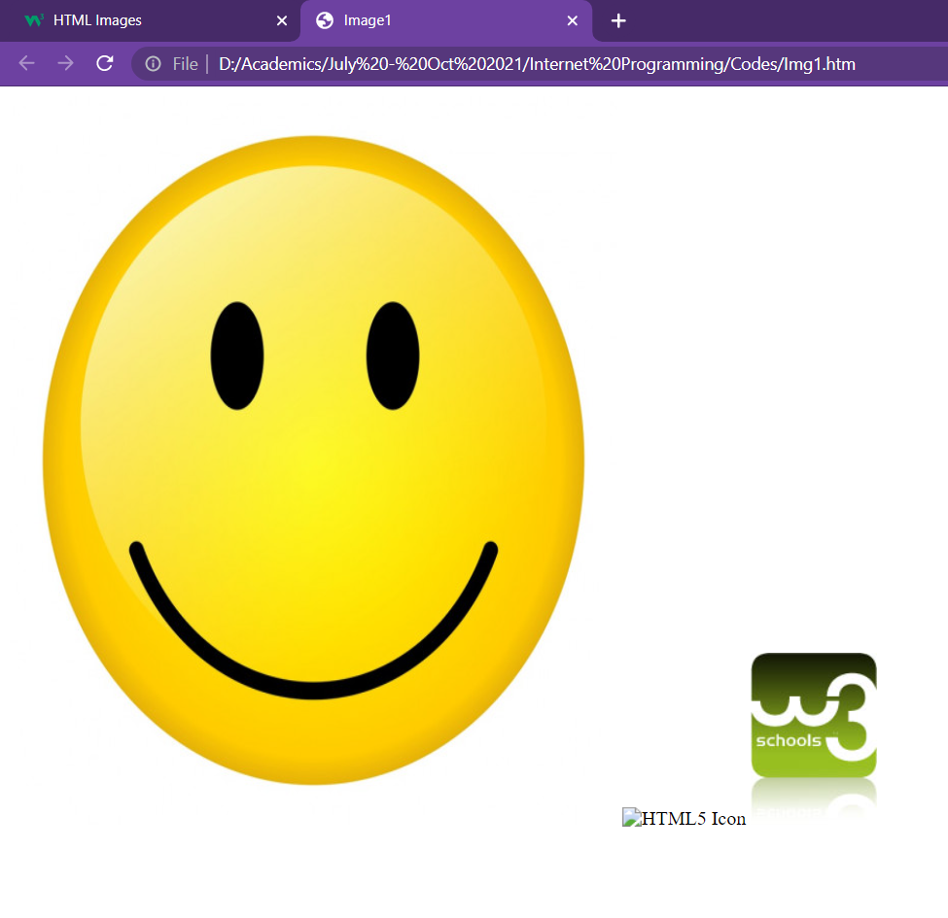
HTML Images
<!DOCTYPE html> <html lang = "en-US"> <head> <title>Images</title> </head> <body>
<img src=“smiley.jpg" alt=“smiley image" width="500" height="600">
<img src="/images/html5.gif" alt="HTML5 Icon" style="width:128px;height:128px;">
<img src="https://www.w3schools.com/images/w3schools_green.jpg" alt="W3Schools.com">
</body>
</html>

Slide 7
HTML Images
<!DOCTYPE html> <html> <head> <style> img { width: 100%; } </style> </head> <body> <img src="html5.gif" alt="HTML5 Icon" width="128" height="128"> <img src="html5.gif" alt="HTML5 Icon" style="width:128px;height:128px;"> </body> </html>
The width, height, and style attributes are all valid in HTML.
Using the style attribute is always preferable.
It prevents styles sheets from changing the size of images

Slide 8
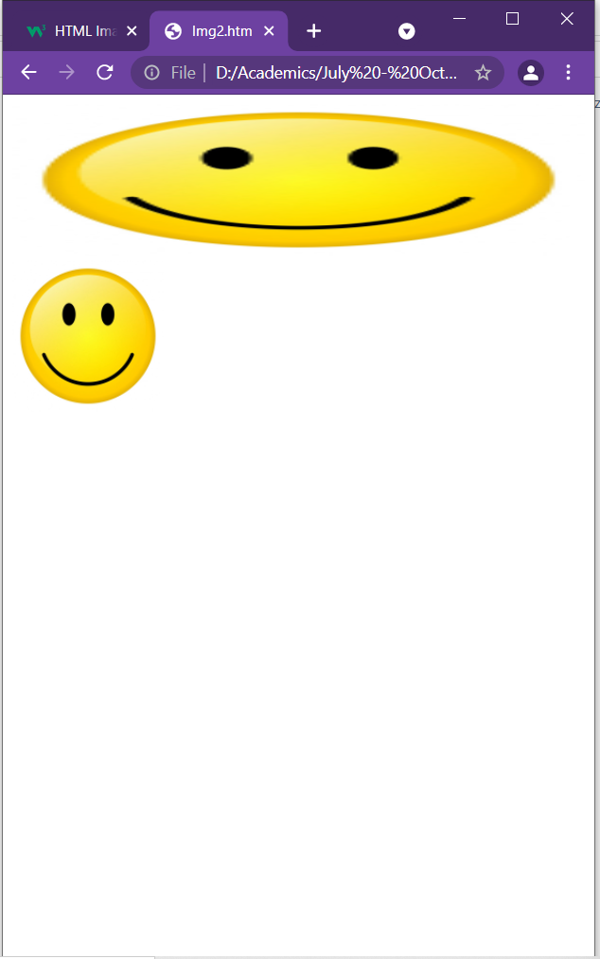
HTML Images
<!DOCTYPE html> <html> <head> <style> img { width: 100%; } </style> </head> <body> <img src="html5.gif" alt="HTML5 Icon" width="128" height="128"> <img src="html5.gif" alt="HTML5 Icon" style="width:128px;height:128px;"> </body> </html>

Slide 9
HTML Forms
An HTML form is used to collect user input.
The user input is most often sent to a server for processing.
The <form> Element
The HTML <form> element is used to create an HTML form for user input:
<form>
. . .
form elements
. . .
</form>
The <form> element is a container for different types of input elements, such as: text fields, checkboxes, radio buttons, submit buttons, etc.

Slide 10
HTML Form Elements
The HTML <form> element can contain one or more of the following form elements:
<input>
<label>
<select>
<textarea>
<button>
<fieldset>
<legend>
<datalist>
<output>
<option>
<optgroup>

Slide 11
HTML Form Elements
<!DOCTYPE html> <html> <head> </head> <body> <form> <label for="fname">First name:</label><br> <input type="text" id="fname" name="fname"><br> <label for="lname">Last name:</label><br> <input type="text" id="lname" name="lname"> </form> </body> </html>
The <input> Element
One of the most used form element is the <input> element.
The <input> element can be displayed in several ways, depending on the type attribute.
The <label> Element
It defines a label for several form elements.
It is useful for screen-reader users
The <label> element also help users who have difficulty clicking on very small regions
The for attribute of the <label> tag should be equal to the id attribute of the <input> element to bind them together.

Slide 12
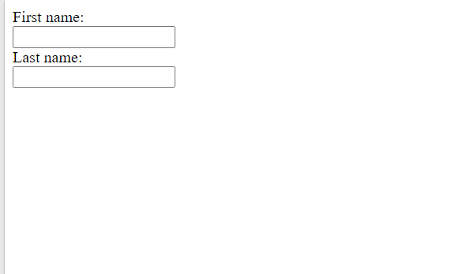
HTML Form Elements
<!DOCTYPE html> <html> <head> </head> <body> <form> <label for="fname">First name:</label><br> <input type="text" id="fname" name="fname"><br> <label for="lname">Last name:</label><br> <input type="text" id="lname" name="lname"> </form> </body> </html>

Slide 13
HTML Form Elements
<!DOCTYPE html> <html> <head> </head> <body> <form> <label for="fname">First name:</label><br> <input type="text" id="fname" name="fname"><br> <label for="lname">Last name:</label><br> <input type="text" id="lname" name="lname"><br>
<p>
<label for="cars">Choose a car:</label> <select id="cars" name="cars" size=“1"> <option value="volvo">Volvo</option> <option value="saab">Saab</option> <option value="fiat">Fiat</option> <option value="audi">Audi</option> </select>
</p> </form> </body> </html>
The <select> Element
It defines drop-down list
The <option> elements
It defines an option that can be selected.
By default, the first item in the drop-down list is selected.
To define a pre-selected option, add the selected attribute to the option
Use the multiple attribute to allow the user to select more than one value:
attribute of the <input> element to bind them together.

Slide 14
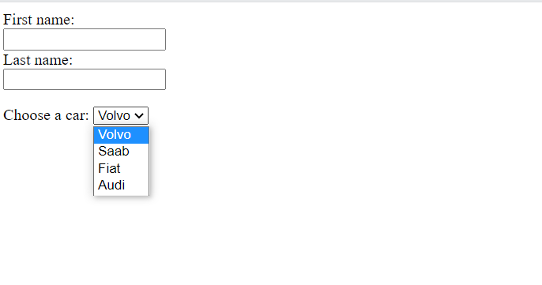
HTML Form Elements
<!DOCTYPE html> <html> <head> </head> <body> <form> <label for="fname">First name:</label><br> <input type="text" id="fname" name="fname"><br> <label for="lname">Last name:</label><br> <input type="text" id="lname" name="lname"><br>
<p>
<label for="cars">Choose a car:</label> <select id="cars" name="cars" size=“1"> <option value="volvo">Volvo</option> <option value="saab">Saab</option> <option value="fiat">Fiat</option> <option value="audi">Audi</option> </select>
</p> </form> </body> </html>

Slide 15
HTML Form Elements
<!DOCTYPE html> <html> <head> </head> <body> <form> <fieldset> <legend>Personalia:</legend> <label for="name">Name:</label><br> <input type="text" id="name" name="name" value="John"><br> <label for=“address">Address:</label><br> <textarea name="message" style="width:200px; height:200px;"> Mumbai </textarea> <br>
<button type="button" onclick="alert('Hello World!')">Click Me!</button> </fieldset>
</form> </body> </html>
The <textarea> Element
The <textarea> element defines a multi-line input field (a text area)
The rows attribute specifies the visible number of lines in a text area.
The cols attribute specifies the visible width of a text area.
The <button> element
It defines a clickable button
The <fieldset> and <legend> element
The <fieldset> element is used to group related data in a form.
The <legend> element defines a caption for the <fieldset> element.

Slide 16
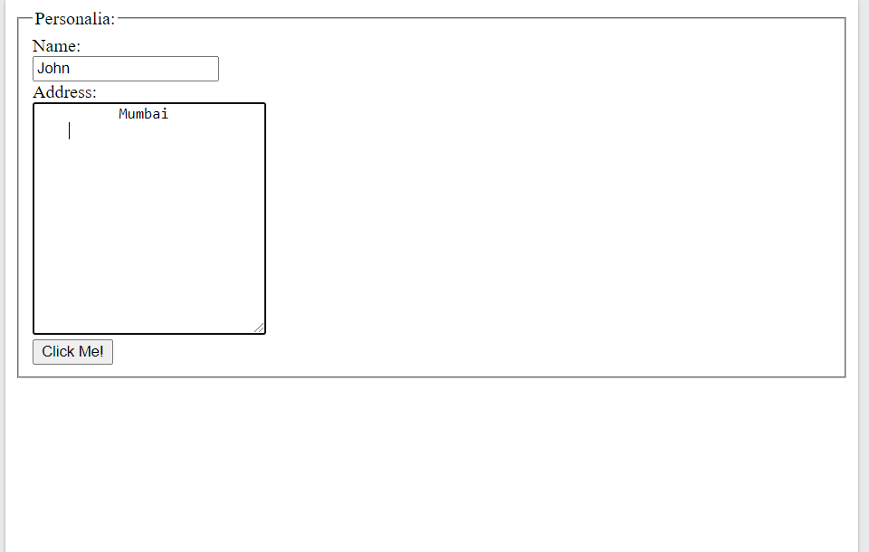
HTML Form Elements
<!DOCTYPE html> <html> <head> </head> <body> <form> <fieldset> <legend>Personalia:</legend> <label for="name">Name:</label><br> <input type="text" id="name" name="name" value="John"><br> <label for=“address">Address:</label><br> <textarea name="message" style="width:200px; height:200px;"> Mumbai </textarea> <br>
<button type="button" onclick="alert('Hello World!')">Click Me!</button> </fieldset>
</form> </body> </html>

Slide 17
HTML Form Elements
<!DOCTYPE html> <html> <head> </head> <body> <form> <label for="fname">First name:</label><br> <input type="text" id="fname" name="fname"><br> <label for="lname">Last name:</label><br> <input type="text" id="lname" name="lname"><br>
<p><label for=“browser">Browser</label><br>
<input list="browsers"> <datalist id="browsers"> <option value="Internet Explorer"> <option value="Firefox"> <option value="Chrome"> <option value="Opera"> <option value="Safari"> </datalist>
</p> </form> </body> </html>
The <datalist> Element
It specifies a list of pre-defined options for an <input> element.
Users will see a drop-down list of the pre-defined options as they input data.
The list attribute of the <input> element, must refer to the id attribute of the <datalist> element.

Slide 18
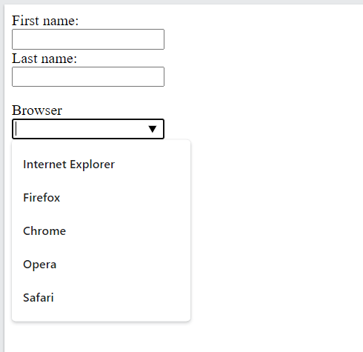
HTML Form Elements
<!DOCTYPE html> <html> <head> </head> <body> <form> <label for="fname">First name:</label><br> <input type="text" id="fname" name="fname"><br> <label for="lname">Last name:</label><br> <input type="text" id="lname" name="lname"><br>
<p><label for=“browser">Browser</label><br>
<input list="browsers"> <datalist id="browsers"> <option value="Internet Explorer"> <option value="Firefox"> <option value="Chrome"> <option value="Opera"> <option value="Safari"> </datalist>
</p> </form> </body> </html>

Slide 19
HTML Form Input Types
There are different input types can be used in HTML
<input type="button"> <input type="checkbox">
<input type="color"> <input type="date">
<input type="datetime-local"> <input type="email">
<input type="file"> <input type="hidden">
<input type="image"> <input type="month">
<input type="number"> <input type="password">
<input type="radio"> <input type="range">
<input type="reset"> <input type="search">
<input type="submit"> <input type="tel">
<input type="text"> <input type="time">
<input type="url"> <input type="week">
The default value of the type attribute is "text".

Slide 20
HTML Form Input Types
Input type Text
<input type="text"> defines a single-line text input field
Input type Password
<input type="password"> defines a password field
The characters in a password field are masked (shown as asterisks or circles)
Input type Submit
<input type="submit"> defines a button for submitting form data to a form-handler.
The form-handler is typically a server page with a script for processing input data.
The form-handler is specified in the form's action attribute
If you omit the submit button's value attribute, the button will get a default text
Input type Reset
<input type="reset"> defines a reset button that will reset all form values to their default values
<!DOCTYPE html> <html> <head> </head> <body> <form> <label for="fname">First name:</label><br> <input type="text" id="fname" name="fname"><br> <label for=“pwd">Password:</label><br> <input type=“password" id=“pwd" name=“pwd"><br><br> <input type="submit" value="Submit"> <input type="reset"> </form> </body> </html>

Slide 21
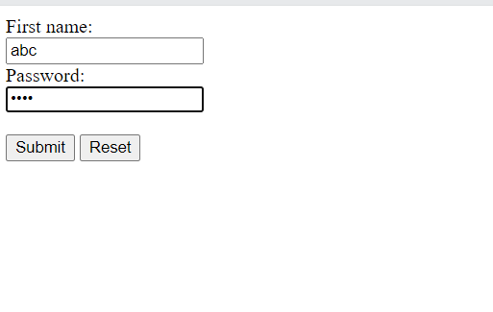
HTML Form Input Types
<!DOCTYPE html> <html> <head> </head> <body> <form> <label for="fname">First name:</label><br> <input type="text" id="fname" name="fname"><br> <label for=“pwd">Password:</label><br> <input type=“password" id=“pwd" name=“pwd"><br><br> <input type="submit" value="Submit"> <input type="reset"> </form> </body> </html>

Slide 22
HTML Form Input Types
<!DOCTYPE html> <html> <head> </head> <body> <form> <input type="radio" id="html" name="fav_language" value="HTML"> <label for="html">HTML</label><br> <input type="radio" id="css" name="fav_language" value="CSS"> <label for="css">CSS</label><br> <input type="radio" id="javascript" name="fav_language" value="JavaScript"> <label for="javascript">JavaScript</label> <hr>
<input type="checkbox" id="vehicle1" name="vehicle1" value="Bike"> <label for="vehicle1"> I have a bike</label><br> <input type="checkbox" id="vehicle2" name="vehicle2" value="Car"> <label for="vehicle2"> I have a car</label><br> <input type="checkbox" id="vehicle3" name="vehicle3" value="Boat"> <label for="vehicle3"> I have a boat</label>
</form> </body> </html>
Input type Radio
<input type="radio"> defines a radio button.
Radio buttons let a user select ONLY ONE of a limited number of choices
Input type Checkbox
<input type="checkbox"> defines a checkbox.
Checkboxes let a user select ZERO or MORE options of a limited number of choices.

Slide 23
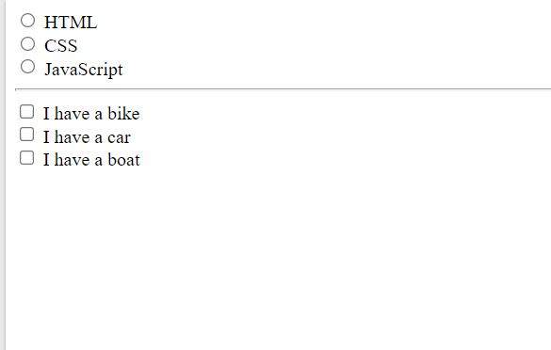
HTML Form Input Types
<!DOCTYPE html> <html> <head> </head> <body> <form> <input type="radio" id="html" name="fav_language" value="HTML"> <label for="html">HTML</label><br> <input type="radio" id="css" name="fav_language" value="CSS"> <label for="css">CSS</label><br> <input type="radio" id="javascript" name="fav_language" value="JavaScript"> <label for="javascript">JavaScript</label> <hr>
<input type="checkbox" id="vehicle1" name="vehicle1" value="Bike"> <label for="vehicle1"> I have a bike</label><br> <input type="checkbox" id="vehicle2" name="vehicle2" value="Car"> <label for="vehicle2"> I have a car</label><br> <input type="checkbox" id="vehicle3" name="vehicle3" value="Boat"> <label for="vehicle3"> I have a boat</label>
</form> </body> </html>

Slide 24
HTML Form Input Types
Input type Button
<input type="button"> defines a button
Input type Color
The <input type="color"> is used for input fields that should contain a color.
Depending on browser support, a color picker can show up in the input field.
Input type Date
The <input type="date"> is used for input fields that should contain a date.
Depending on browser support, a date picker can show up in the input field.
You can also use the min and max attributes to add restrictions to dates
Input type File
The <input type="file"> defines a file-select field and a "Browse" button for file uploads.
Input type Email
The <input type="email"> is used for input fields that should contain an e-mail address.
The e-mail address can be automatically validated when submitted.
Some smartphones recognize the email type, and add ".com" to the keyboard to match email input.
<!DOCTYPE html> <html> <head> </head> <body> <form> <input type="button" onclick="alert('Hello World!')" value="Click Me!"> <hr>
<label for="favcolor">Select your favorite color:</label> <input type="color" id="favcolor" name="favcolor"> <hr>
<label for="datemax">Enter a date before 1980-01-01:</label> <input type="date" id="datemax" name="datemax" max="1979-12-31"><br><br> <label for="datemin">Enter a date after 2000-01-01:</label> <input type="date" id="datemin" name="datemin" min="2000-01-02"> <hr>
<label for="myfile">Select a file:</label> <input type="file" id="myfile" name="myfile"> <hr>
<label for="email">Enter your email:</label> <input type="email" id="email" name="email">
</form> </body> </html>

Slide 25
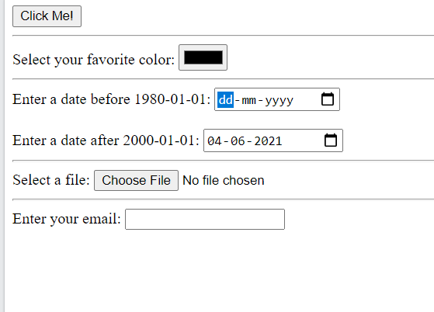
HTML Form Input Types
<!DOCTYPE html> <html> <head> </head> <body> <form> <input type="button" onclick="alert('Hello World!')" value="Click Me!"> <hr>
<label for="favcolor">Select your favorite color:</label> <input type="color" id="favcolor" name="favcolor"> <hr>
<label for="datemax">Enter a date before 1980-01-01:</label> <input type="date" id="datemax" name="datemax" max="1979-12-31"><br><br> <label for="datemin">Enter a date after 2000-01-01:</label> <input type="date" id="datemin" name="datemin" min="2000-01-02"> <hr>
<label for="myfile">Select a file:</label> <input type="file" id="myfile" name="myfile"> <hr>
<label for="email">Enter your email:</label> <input type="email" id="email" name="email">
</form> </body> </html>

Slide 26
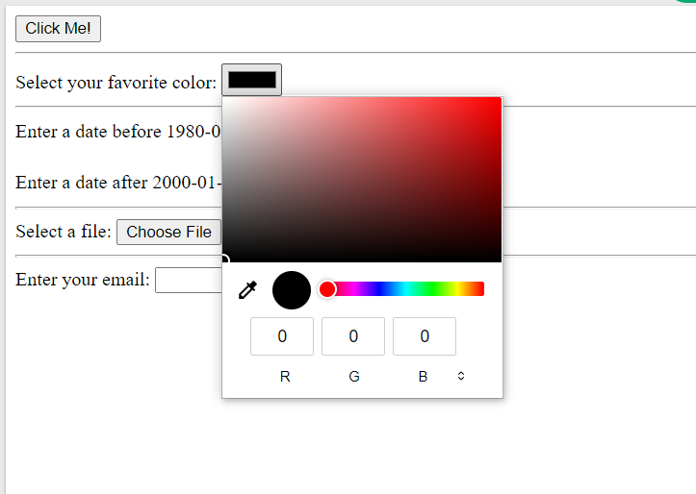
HTML Form Input Types
<!DOCTYPE html> <html> <head> </head> <body> <form> <input type="button" onclick="alert('Hello World!')" value="Click Me!"> <hr>
<label for="favcolor">Select your favorite color:</label> <input type="color" id="favcolor" name="favcolor"> <hr>
<label for="datemax">Enter a date before 1980-01-01:</label> <input type="date" id="datemax" name="datemax" max="1979-12-31"><br><br> <label for="datemin">Enter a date after 2000-01-01:</label> <input type="date" id="datemin" name="datemin" min="2000-01-02"> <hr>
<label for="myfile">Select a file:</label> <input type="file" id="myfile" name="myfile"> <hr>
<label for="email">Enter your email:</label> <input type="email" id="email" name="email">
</form> </body> </html>

Slide 27
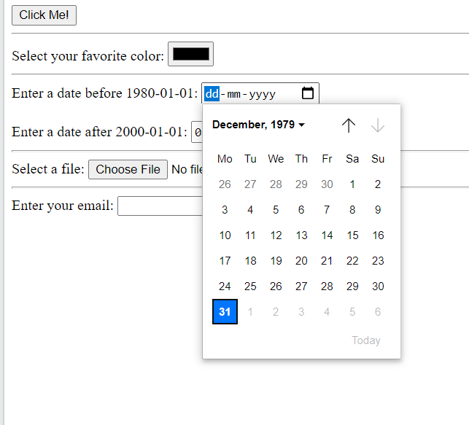
HTML Form Input Types
<!DOCTYPE html> <html> <head> </head> <body> <form> <input type="button" onclick="alert('Hello World!')" value="Click Me!"> <hr>
<label for="favcolor">Select your favorite color:</label> <input type="color" id="favcolor" name="favcolor"> <hr>
<label for="datemax">Enter a date before 1980-01-01:</label> <input type="date" id="datemax" name="datemax" max="1979-12-31"><br><br> <label for="datemin">Enter a date after 2000-01-01:</label> <input type="date" id="datemin" name="datemin" min="2000-01-02"> <hr>
<label for="myfile">Select a file:</label> <input type="file" id="myfile" name="myfile"> <hr>
<label for="email">Enter your email:</label> <input type="email" id="email" name="email">
</form> </body> </html>

Slide 28
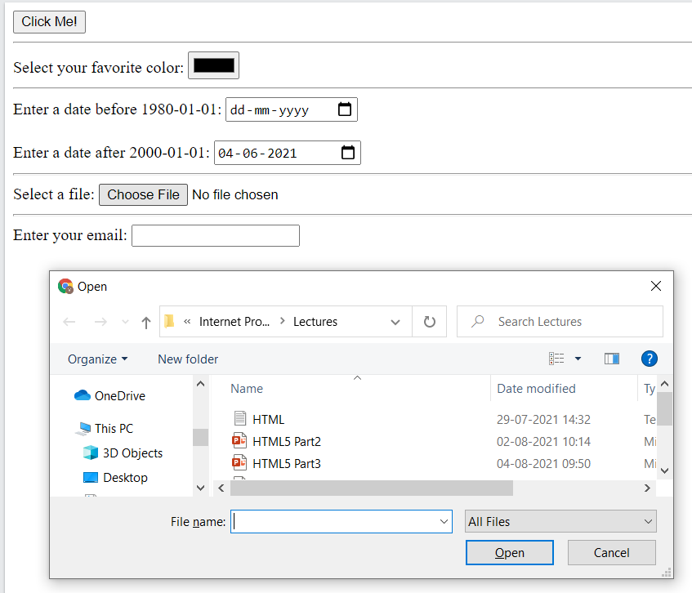
HTML Form Input Types
<!DOCTYPE html> <html> <head> </head> <body> <form> <input type="button" onclick="alert('Hello World!')" value="Click Me!"> <hr>
<label for="favcolor">Select your favorite color:</label> <input type="color" id="favcolor" name="favcolor"> <hr>
<label for="datemax">Enter a date before 1980-01-01:</label> <input type="date" id="datemax" name="datemax" max="1979-12-31"><br><br> <label for="datemin">Enter a date after 2000-01-01:</label> <input type="date" id="datemin" name="datemin" min="2000-01-02"> <hr>
<label for="myfile">Select a file:</label> <input type="file" id="myfile" name="myfile"> <hr>
<label for="email">Enter your email:</label> <input type="email" id="email" name="email">
</form> </body> </html>

Slide 29
HTML Form Attributes
The Action Attribute
The action attribute defines the action to be performed when the form is submitted.
Usually, the form data is sent to a file on the server when the user clicks on the submit button.
The Target Attribute
The target attribute specifies where to display the response that is received after submitting the form.
The target attribute can have one of the following values:
Value Description
_blank The response is displayed in a new window or tab
_self The response is displayed in the current window
_parent The response is displayed in the parent frame
_top The response is displayed in the full body of the window
framename The response is displayed in a named iframe

Slide 30
HTML Form Attributes
The Method Attribute
The method attribute specifies the HTTP method to be used when submitting the form data.
The form-data can be sent as URL variables (with method="get") or as HTTP post transaction (with method="post").
The default HTTP method when submitting form data is GET.
Example: <form action="/action_page.php" method="get">
Important points about GET:
Appends the form data to the URL, in name/value pairs
NEVER use GET to send sensitive data! (the submitted form data is visible in the URL!)
The length of a URL is limited (2048 characters)
Useful for form submissions where a user wants to bookmark the result
GET is good for non-secure data, like query strings in Google

Slide 31
HTML Form Attributes
The Method Attribute
The method attribute specifies the HTTP method to be used when submitting the form data.
The form-data can be sent as URL variables (with method="get") or as HTTP post transaction (with method="post").
The default HTTP method when submitting form data is GET.
Example: <form action="/action_page.php" method=“POST">
Important points on POST:
Appends the form data inside the body of the HTTP request (the submitted form data is not shown in the URL)
POST has no size limitations, and can be used to send large amounts of data.
Form submissions with POST cannot be bookmarked
Always use POST if the form data contains sensitive or personal information!

Slide 32
HTML Form Attributes
The Autocomplete Attribute
The autocomplete attribute specifies whether a form should have autocomplete on or off.
When autocomplete is on, the browser automatically complete values based on values that the user has entered before.
Example: <form action="/action_page.php" autocomplete="on">
The Novalidate attribute
The novalidate attribute is a boolean attribute.
When present, it specifies that the form-data (input) should not be validated when submitted.

